Slide 1
Minimum Spanning Trees
2704
867
BOS
849
PVD
ORD
740
187
144
1846
621
JFK
802
184
1258
SFO
1391
BWI
337
1464
1090
LAX
1235
DFW
946
1121
MIA
2342

Slide 2

Outline and Reading
Minimum Spanning Trees (§12.7)
  Definitions
  A crucial fact
The Prim-Jarnik Algorithm (§12.7.2)
Kruskal's Algorithm (§12.7.1)
Baruvka's Algorithm

Slide 3
Minimum Spanning Tree
Spanning subgraph
  Subgraph of a graph G containing all the vertices of G
Spanning tree
  Spanning subgraph that is itself a (free) tree
Minimum spanning tree (MST)
  Spanning tree of a weighted graph with minimum total edge weight
Applications
  Communications networks
  Transportation networks
ORD
10
1
PIT
DEN
6
7
9
3
DCA
4
STL
8
5
2
DFW
ATL

Slide 4
Cycle Property
f
8
Cycle Property:
  Let T be a minimum spanning tree of a weighted graph G
  Let e be an edge of G that is not in T and C let be the cycle formed by e with T
  For every edge f of C, weight(f) ≤ weight(e)
  Proof:
  By contradiction
  If weight(f) > weight(e) we can get a spanning tree of smaller weight by replacing e with f
4
C
9
2
6
3
e
8
7
7
Replacing f with e yields
a better spanning tree
f
8
4
C
9
2
6
3
e
8
7
7

Slide 5
Partition Property
U
V
f
7
Partition Property:
  Consider a partition of the vertices of G into subsets U and V
  Let e be an edge of minimum weight across the partition
  There is a minimum spanning tree of G containing edge e
  Proof:
  Let T be an MST of G
  If T does not contain e, consider the cycle C formed by e with T and let f be an edge of C across the partition
  By the cycle property,
  weight(f) ≤ weight(e)
  Thus, weight(f) = weight(e)
  We obtain another MST by replacing f with e
4
9
2
5
8
8
e
3
7
Replacing f with e yields
another MST
U
V
f
7
4
9
2
5
8
8
e
3
7

Slide 6
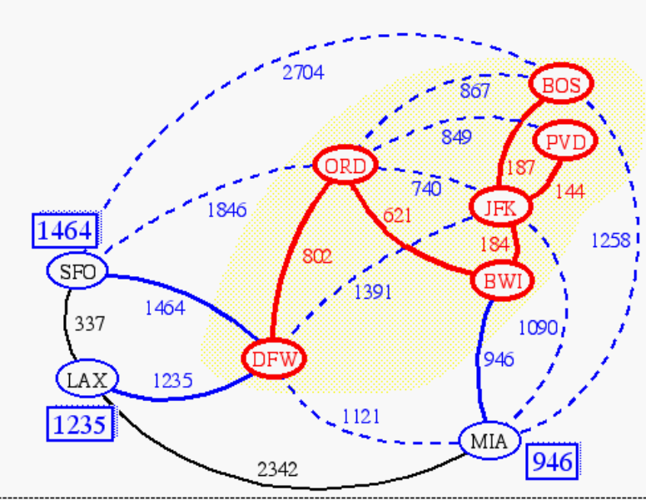
Prim-Jarnik’s Algorithm
Similar to Dijkstra’s algorithm (for a connected graph)
We pick an arbitrary vertex s and we grow the MST as a cloud of vertices, starting from s
We store with each vertex v a label d(v) = the smallest weight of an edge connecting v to a vertex in the cloud
At each step:
  We add to the cloud the vertex u outside the cloud with the smallest distance label
  We update the labels of the vertices adjacent to u

Slide 7
Prim-Jarnik’s Algorithm (cont.)
A priority queue stores the vertices outside the cloud
  Key: distance
  Element: vertex
Locator-based methods
  insert(k,e) returns a locator
  replaceKey(l,k) changes the key of an item
We store three labels with each vertex:
  Distance
  Parent edge in MST
  Locator in priority queue
Algorithm PrimJarnikMST(G)
Q ← new heap-based priority queue
s ← a vertex of G
for all v ∈ G.vertices()
if v = s
setDistance(v, 0)
else
setDistance(v, ∞)
setParent(v, ∅)
l ← Q.insert(getDistance(v), v)
  setLocator(v,l)
  while ¬Q.isEmpty()
  u ← Q.removeMin()
  for all e ∈ G.incidentEdges(u)
  z ← G.opposite(u,e)
  r ← weight(e)
  if r < getDistance(z)
  setDistance(z,r)
  setParent(z,e)
  Q.replaceKey(getLocator(z),r)

Slide 8
Example
∞
7
2
7
D
2
7
D
B
4
B
4
8
9
∞
5
9
∞
2
5
F
2
5
F
C
8
C
8
8
3
8
3
E
E
A
7
7
A
7
7
0
0
7
7
2
7
D
7
D
B
4
2
B
4
5
9
∞
9
4
2
5
F
5
5
C
2
F
8
C
8
8
3
3
E
8
A
7
E
0
7
A
7
7
0

Slide 9
Example (contd.)
7
2
7
D
B
4
5
9
4
2
5
F
C
8
8
3
E
A
7
3
7
0
7
D
2
B
4
5
9
4
2
5
F
C
8
8
3
E
A
7
3
0

Slide 10
Analysis
Graph operations
  Method incidentEdges is called once for each vertex
Label operations
  We set/get the distance, parent and locator labels of vertex z O(deg(z)) times
  Setting/getting a label takes O(1) time
Priority queue operations
  Each vertex is inserted once into and removed once from the priority queue, where each insertion or removal takes O(log n) time
  The key of a vertex w in the priority queue is modified at most deg(w) times, where each key change takes O(log n) time
Prim-Jarnik’s algorithm runs in O((n + m) log n) time provided the graph is represented by the adjacency list structure
  Recall that Σ_{v} deg(v) = 2m
The running time is O(m log n) since the graph is connected

Slide 11
Kruskal’s Algorithm
A priority queue stores the edges outside the cloud
  Key: weight
  Element: edge
At the end of the algorithm
  We are left with one cloud that encompasses the MST
  A tree T which is our MST
Algorithm KruskalMST(G)
for each vertex V in G do
define a Cloud(v) of ← {v}
let Q be a priority queue.
Insert all edges into Q using their weights as the key
T ← ∅
while T has fewer than n-1 edges do edge e = T.removeMin()
Let u, v be the endpoints of e
if Cloud(v) ≠ Cloud(u) then
Add edge e to T
Merge Cloud(v) and Cloud(u)
return T

Slide 12
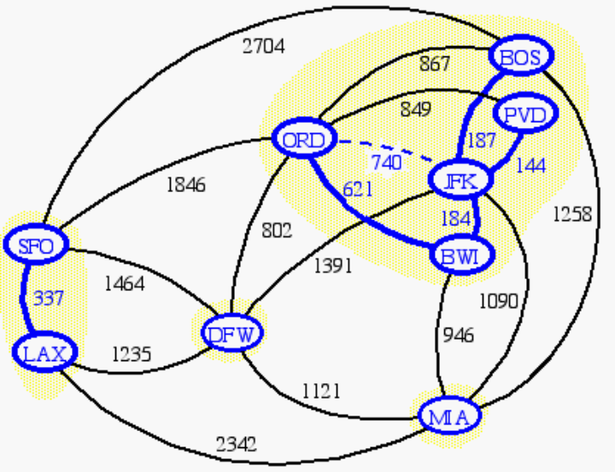
Data Structure for Kruskal Algortihm
The algorithm maintains a forest of trees
An edge is accepted it if connects distinct trees
We need a data structure that maintains a partition, i.e., a collection of disjoint sets, with the operations:
-find(u): return the set storing u
-union(u,v): replace the sets storing u and v with their union

Slide 13
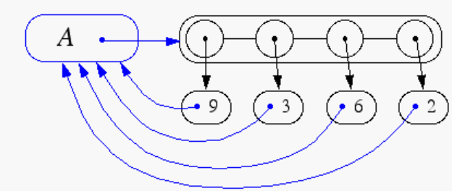
Representation of a Partition
Each set is stored in a sequence
Each element has a reference back to the set
  operation find(u) takes O(1) time, and returns the set of which u is a member.
  in operation union(u,v), we move the elements of the smaller set to the sequence of the larger set and update their references
  the time for operation union(u,v) is min(n_{u},n_{v}), where n_{u} and n_{v} are the sizes of the sets storing u and v
Whenever an element is processed, it goes into a set of size at least double, hence each element is processed at most log n times

Slide 14
Partition-Based Implementation
A partition-based version of Kruskal’s Algorithm performs cloud merges as unions and tests as finds.
Algorithm Kruskal(G):
Input: A weighted graph G.
Output: An MST T for G.
Let P be a partition of the vertices of G, where each vertex forms a separate set.
Let Q be a priority queue storing the edges of G, sorted by their weights
Let T be an initially-empty tree
while Q is not empty do
(u,v) ← Q.removeMinElement()
if P.find(u) != P.find(v) then
Add (u,v) to T
P.union(u,v)
return T
Running time: O((n+m)log n)

Slide 15
Kruskal Example
2704
867
BOS
849
PVD
ORD
187
740
144
1846
621
JFK
184
1258
802
SFO
BWI
1391
1464
337
1090
DFW
946
LAX
1235
1121
MIA
2342

Slide 16
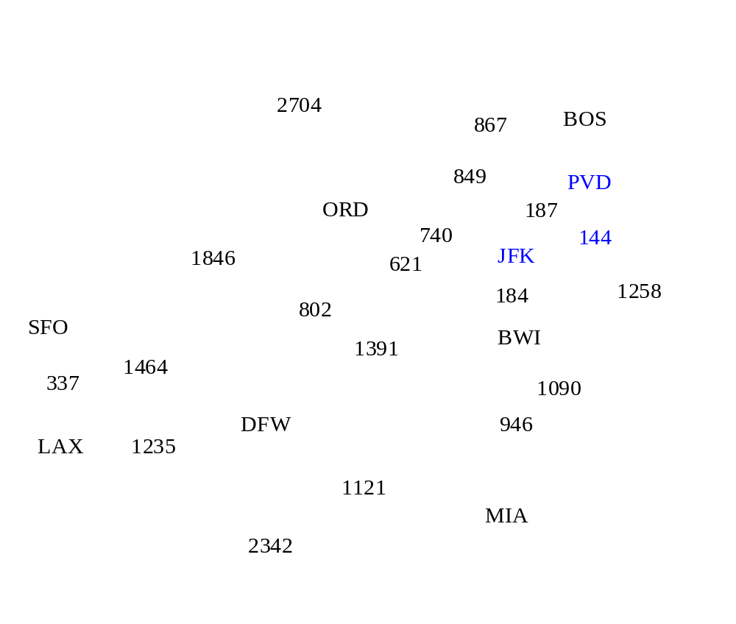
Example

Slide 17
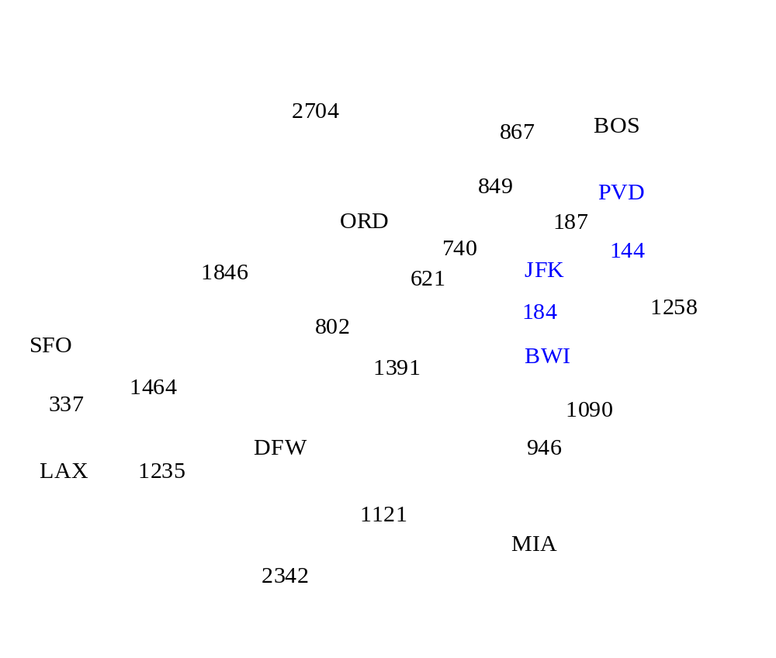
Example

Slide 18
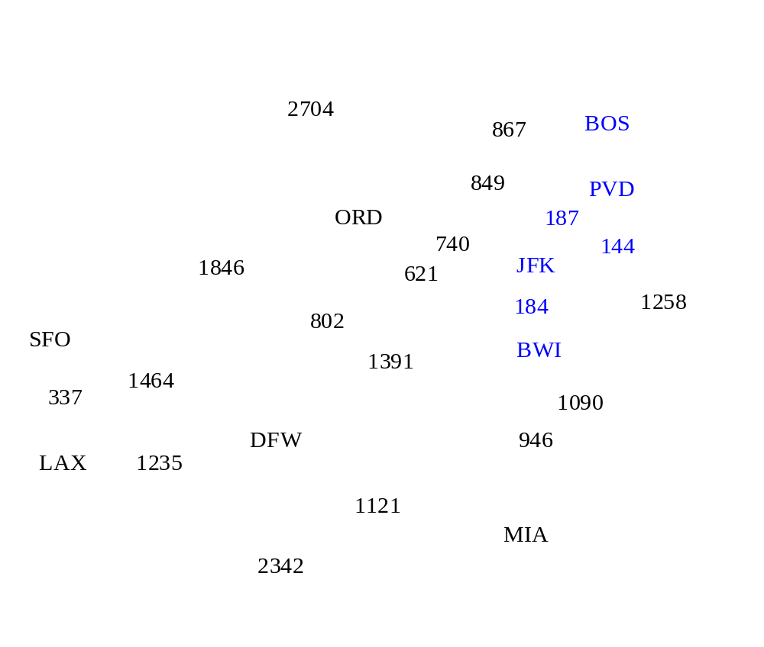
Example

Slide 19
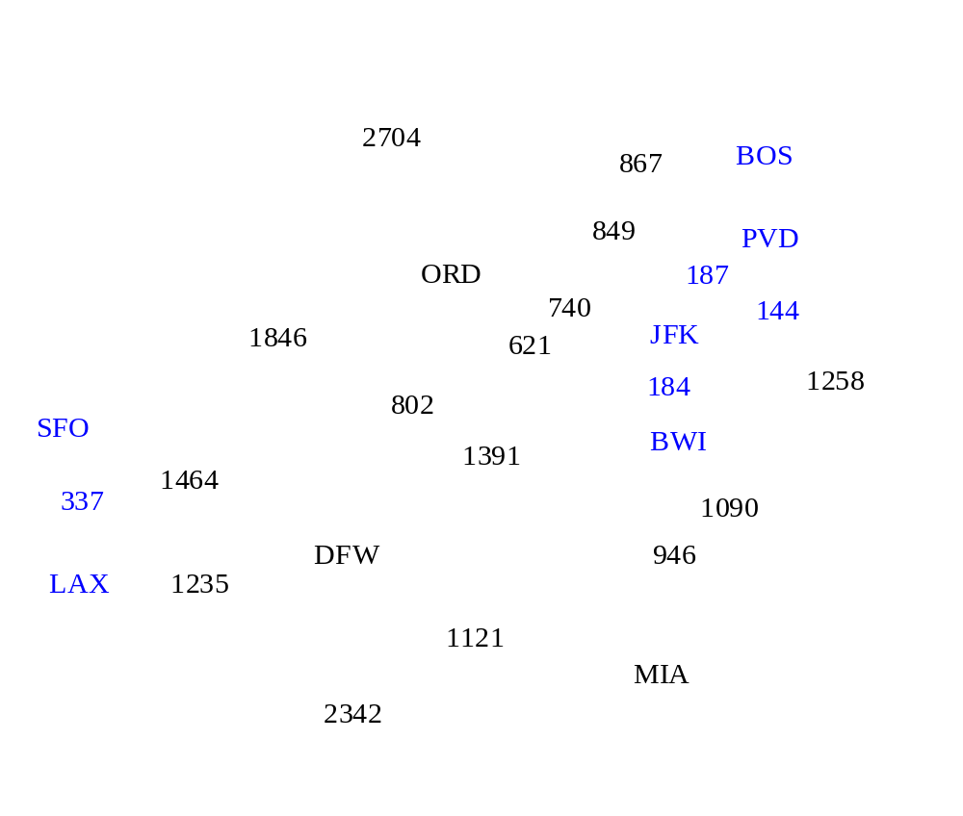
Example

Slide 20
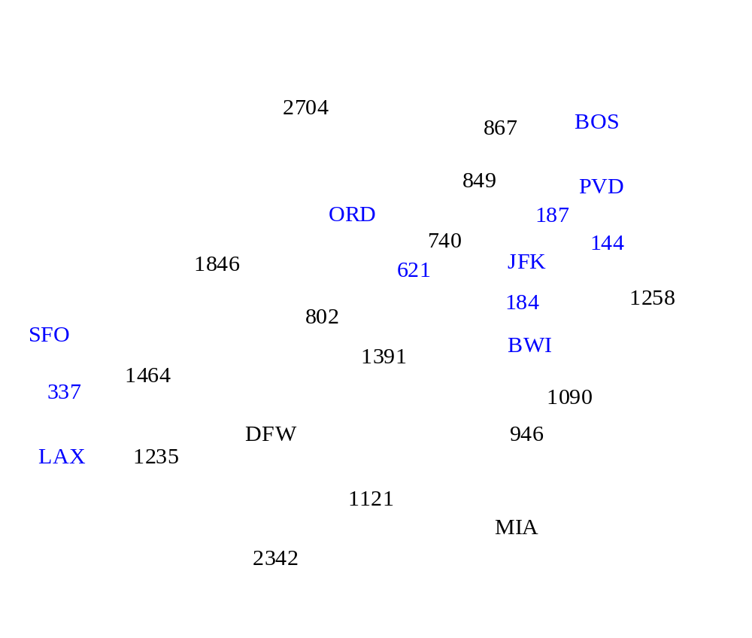
Example

Slide 21
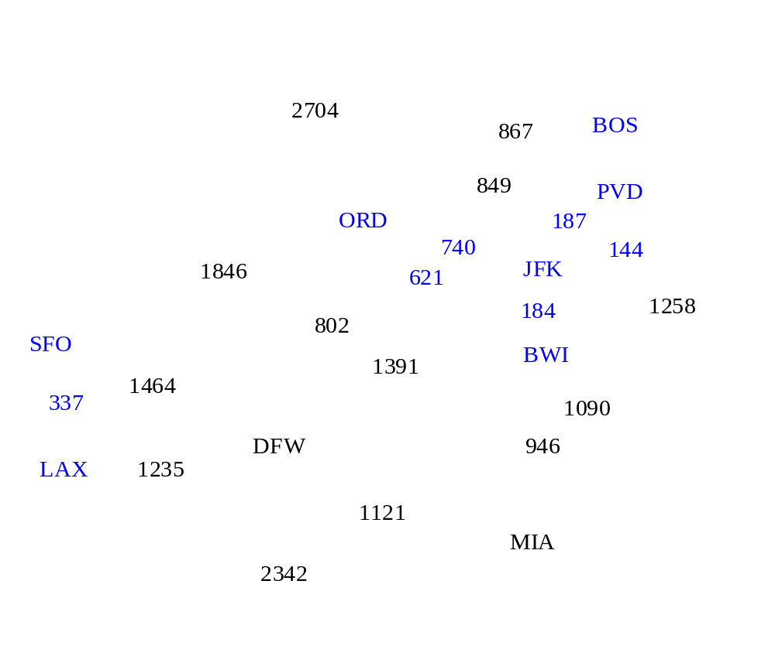
Example

Slide 22
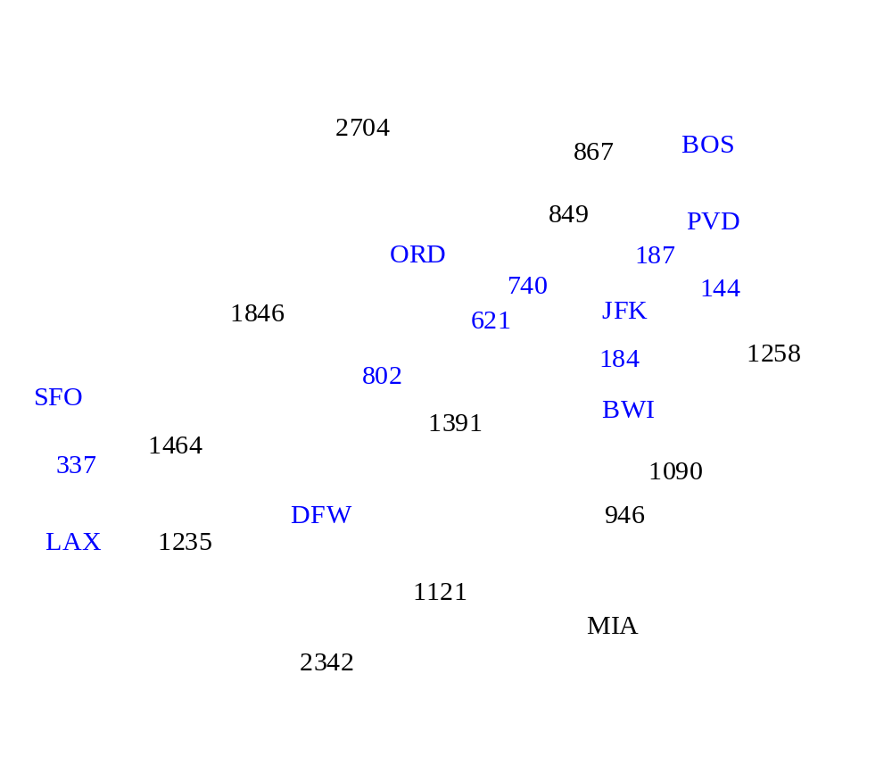
Example

Slide 23
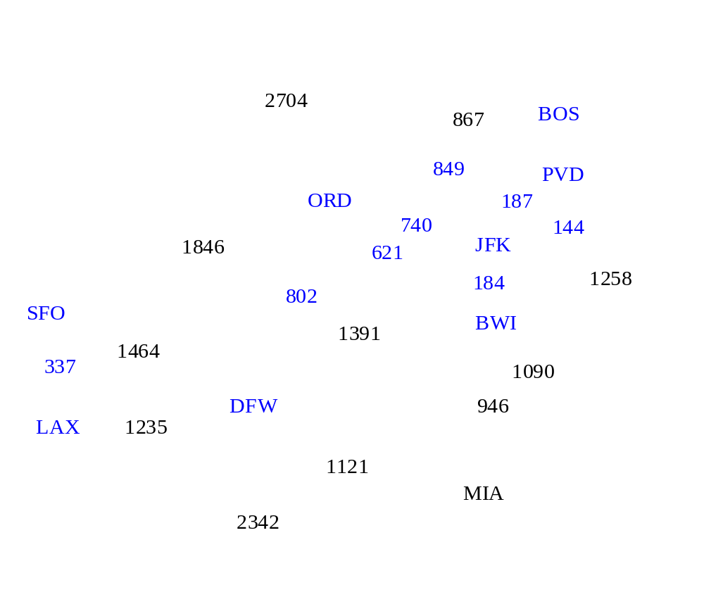
Example

Slide 24
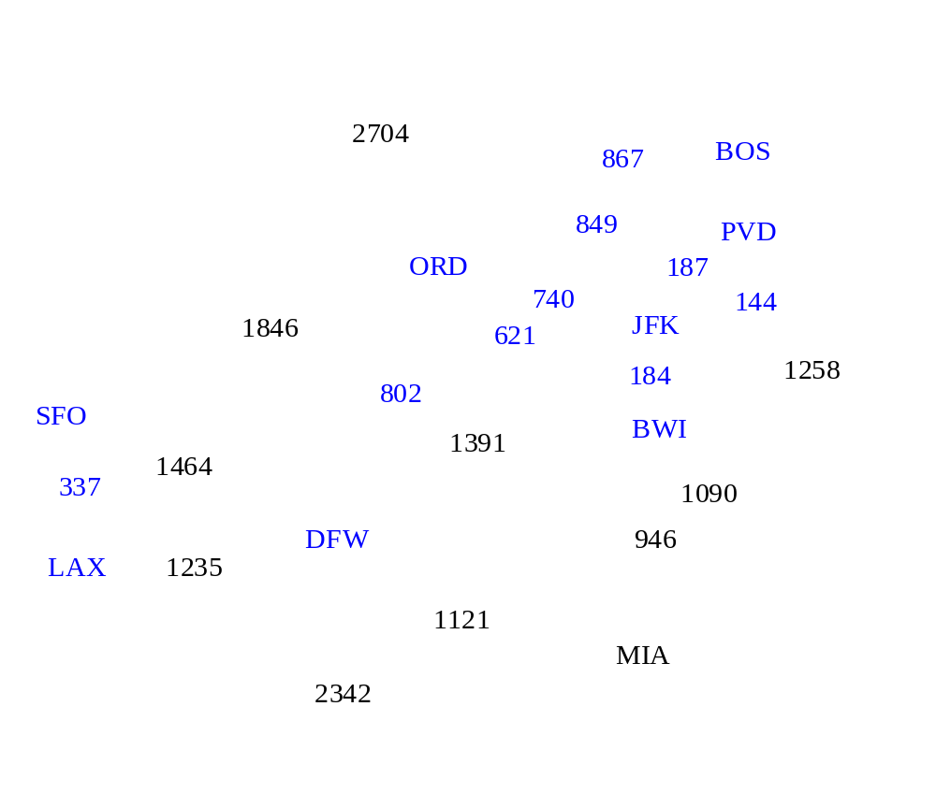
Example

Slide 25

Example

Slide 26
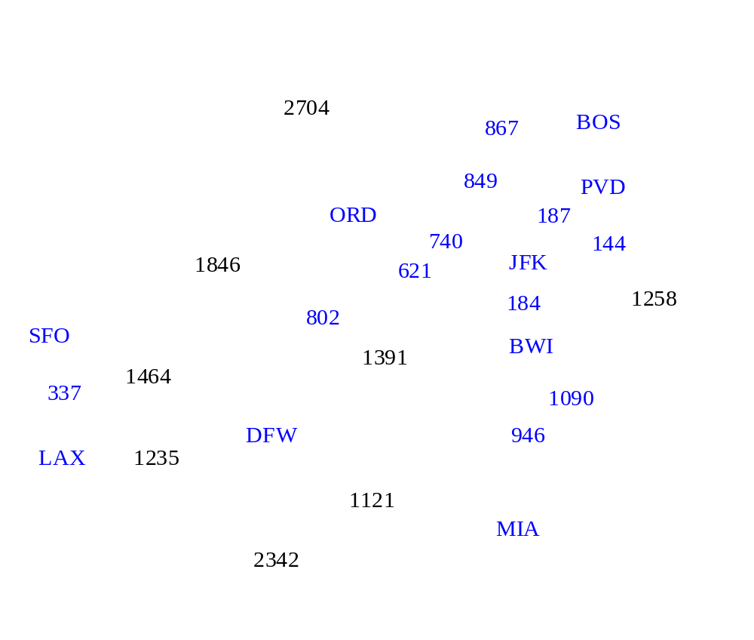
Example

Slide 27

Example

Slide 28
Example
2704
867
BOS
849
PVD
ORD
187
740
144
1846
621
JFK
184
1258
802
SFO
BWI
1391
1464
337
1090
DFW
946
LAX
1235
1121
MIA
2342

Slide 29
Baruvka’s Algorithm
Like Kruskal’s Algorithm, Baruvka’s algorithm grows many “clouds” at once.
Each iteration of the while-loop halves the number of connected compontents in T.
  The running time is O(m log n).
Algorithm BaruvkaMST(G)
T ← V {just the vertices of G}
while T has fewer than n-1 edges do
for each connected component C in T do
Let edge e be the smallest-weight edge from C to another component in T.
if e is not already in T then
Add edge e to T
return T

Slide 30
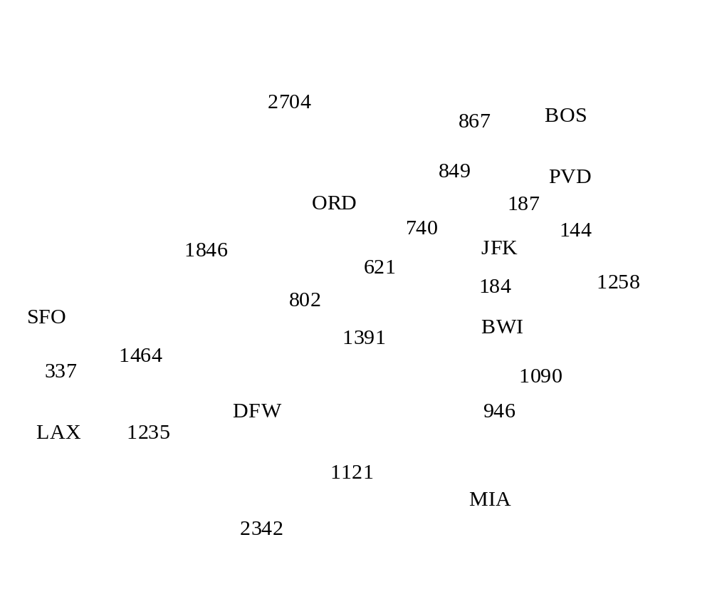
Baruvka Example

Slide 31
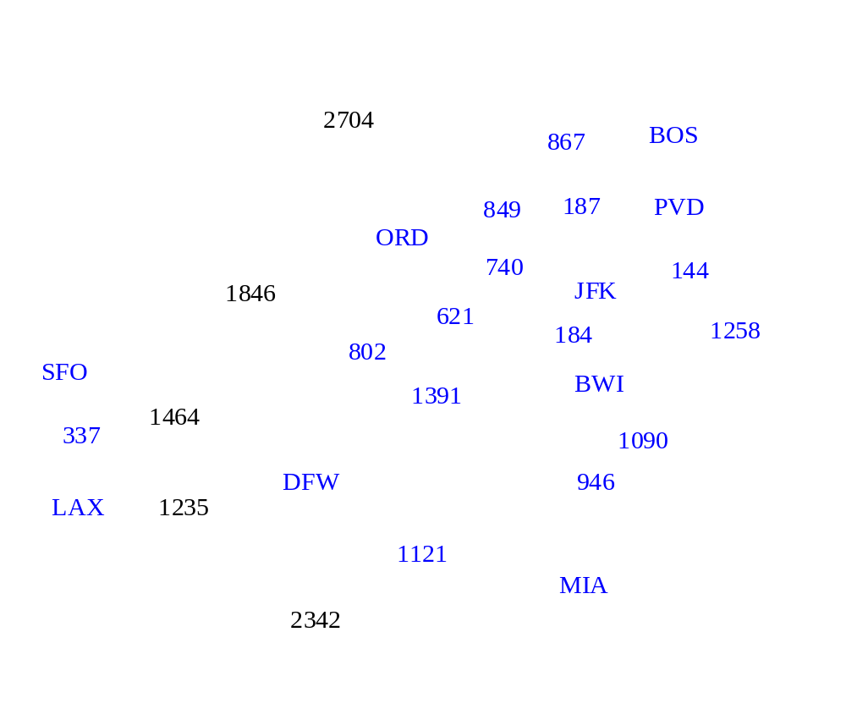
Example

Slide 32
Example
2704
867
BOS
849
187
PVD
ORD
740
144
1846
JFK
621
184
1258
802
SFO
BWI
1391
1464
337
1090
DFW
946
LAX
1235
1121
MIA
2342

